Slide 1
Process Discovery Using Python - Praktikum
Madhavi Shankar Junxiong Gao(Frank)
RWTH Aachen University RWTH Aachen University
madhavi.shankar@pads.rwth-aachen.de jx.gao@pads.rwth-aachen.de

Slide 2
Project Initiation - Documentation
Phases:
Develop a Business Case
Undertake a Feasibility Study
Establish the Project Charter
Appoint the Project Team
Set up the Project Office
Perform a Initiation review

Slide 3
PROCESS DISCOVERY USING PYTHON: ESSENTIAL INFORMATION
Grading:
For the Bachelor’s: Grading based on the assignments and milestones.
For the Master’s: 28% on the assignments, 72% on a final oral examination that shall be conducted between 08/07/2019 and 17/07/2019.

Slide 4
Develop a Business Case
Explain the benefits gained from business point of view by undertaking the project.
Key benefits already identified by the business (in the assignment), add points to it and also consider how these benefits will be measured and when they will be realized.
Generally includes Overview, Scope, Assumptions and a new notes(if need to be documented)

Slide 5
Undertake a Feasibility Study
From theoretical point of view: refer to documentation/papers
From technical point of view: report some real use cases (google it) of Python and Flask in providing Enterprise Level applications, also for compliance checking
Generally includes documentation of what we are trying to achieve or address. Identifies potential Risks and Issues.

Slide 6
Establish the Project Charter
Which are the milestones of the project? (refer to the dates of the course)
Do an initial GANTT diagram of expected times for project phases, also referring to milestone dates.
Generally lists the milestones, deliverables and mitigation plan for risks and potential issues.

Slide 7
Appoint the Project Team
Convince the business you are competent enough to undertake the task.
Brief description of yourself, along with a real and honest self-assessment on theoretical and programming capabilities
Assign ROLES inside the team. They are not strict roles (all of you for example are assumed to have a part in writing the code), but responsibilities shall be clearly identified.
Generally specifies who is doing what, experience level and associated skill set and risks like working condition issues.

Slide 8
Set up the Project Office
Generally contains information on the execution location and logistics involved. This includes the details of the core team and also the support staff like the infrastructure teams
For assignment case, we follow an online model for project office and tracking. Let us use

Slide 9
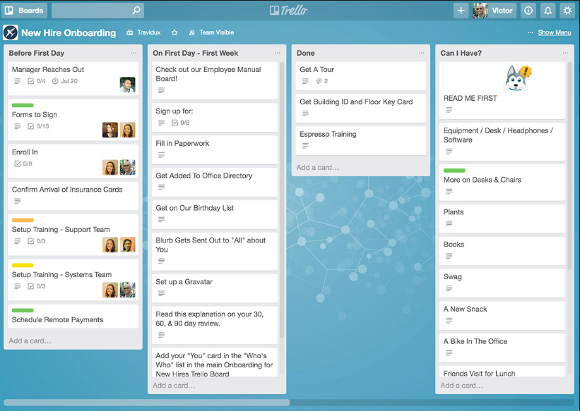
Set up the Project Office (1/2)
Suggested usage of Trello for task assignation, time keeping, monitoring, status report
Usually four columns shall be created:
TO BE PLANNED
RUNNING TASKS
COMPLETED TASKS
SUSPENDED TASKS (a planned/running task that has to be interrupted, due to changed priorities or lack of time)
Share the dashboard with all the members of your group and with me

Slide 10
Set up the Project Office (2/2)
Code management through Git
Create a (private) repository in Github or Bitbucket
Share the dashboard with all the members of your group and with me

Slide 11
Perform a Initiation review
Each of you has to provide some feedback on how things have worked out in this first phase
If there are issues/discrepancies in the group it’s better to fix them now than later!
Ability to do a proper phase review is important in project management
Generally reserved for verification that the project initiation has happened correctly and all aspects have been considered.
A Proper review phase ensures no steps are missed.
Provide Trello dashboard and Github repository for Project Initiation phase before Friday 12 April 2019, 23:59:59 CET ☺ otherwise 0.0 points for you
Submission of the Project initiation document by 22nd April 2019, 23:59:59 CET.

